Slide 1
Customizable Active Noise CanceLlation Headphones
Shannon Garvey, Benjamin Johnson, and STEVEN OHANESIAN

Slide 2


Goals
Build high quality headphones with working Active Noise Cancellation
Create an app to measure individual’s hearing and adjust to it
Save individual’s hearing profiles
Have different equalizer settings for different types of music

Slide 3
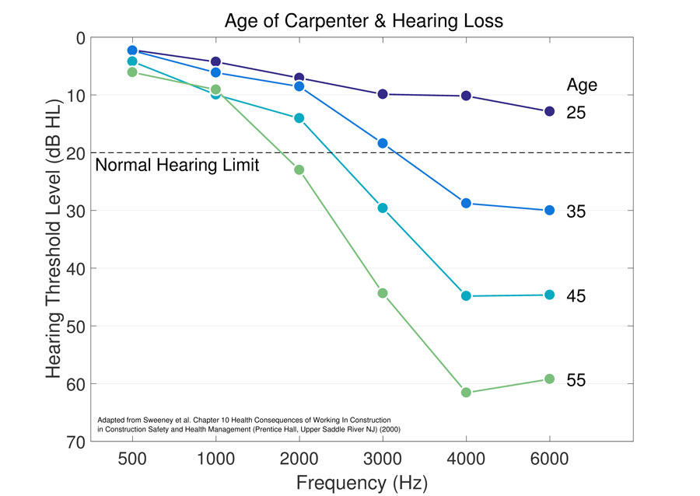
Problems Addressed
Poor listening experience due to random noise interference
Psycho-acoustical differences between humans
Ear shape and other natural variations
Hearing damage
Age

Slide 4
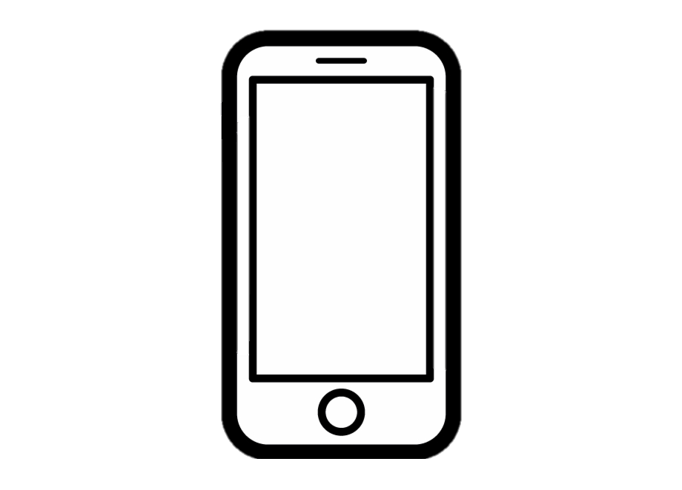

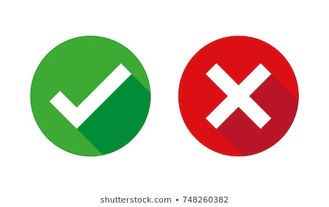
APP
Did you hear something?

Slide 5
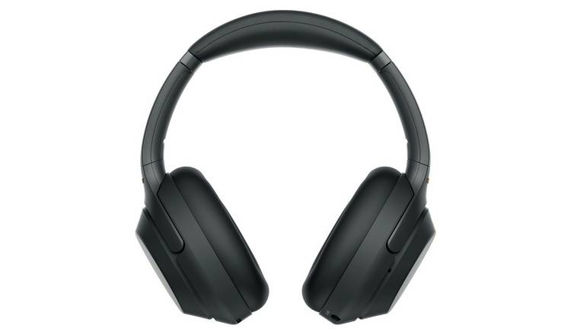
Hardware
Headphone body
Bluetooth and DSP capabilities
Audio drivers
ANC DMEMS Microphones

Slide 6
Questions?

